Slide 1
CAPSTONE PROJECT
Secure Data Hiding in Image Using Steganography
Presented By :- Suraj Mohapatra
Student Name :- Suraj Mohapatra
College Name & Department :- Gandhi Institute of Technological Advancement (GITA)
MCA

Slide 2
OUTLINE
Problem Statement
Technology used
Wow factor
End users
Result
Conclusion
Git-hub Link
Future scope

Slide 3
Problem Statement
This project aims to develop an advanced steganography tool that securely hides encrypted messages within image files, ensuring confidential communication for Marcos Commando operations.

Slide 4
Technology used
Python 🐍
OpenCV (cv2) 🖼️
NumPy 🔢
Cryptography (fernet) 🔒
Hashlib (SHA-256) 🔑

Slide 5
Wow factors
⚡ Fast and efficient encoding/decoding using NumPy operations.
🔐 Strong encryption using Fernet (symmetric encryption based on AES).
🖼️ Password-based authentication for secure message extraction.
🔄 Automatic generation of unique encrypted image files to prevent overwriting.
🛡️ Data integrity checks to ensure accurate decryption.

Slide 6
End users
🪖 Marcos Commando Units
🛡️ Defense and Intelligence Agencies

Slide 7
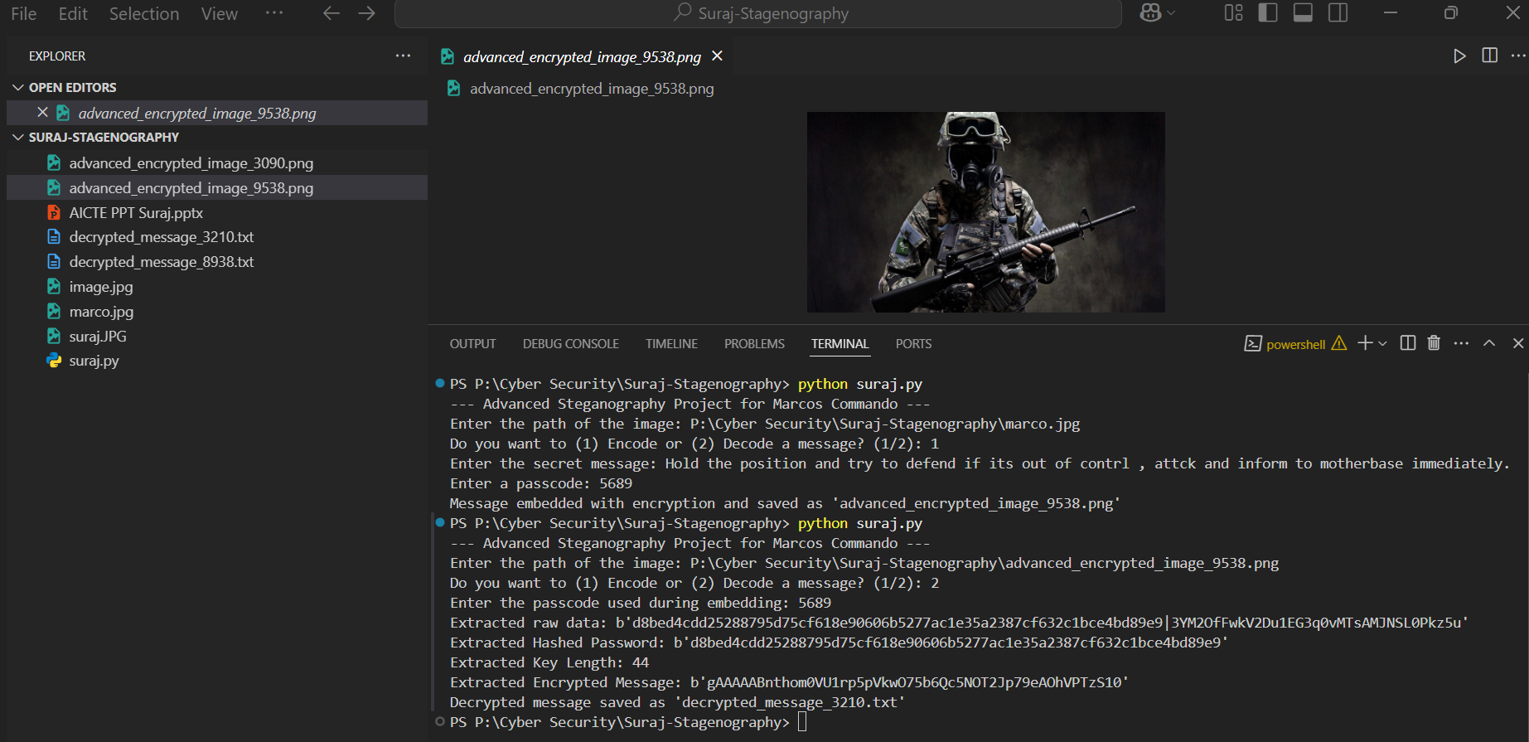
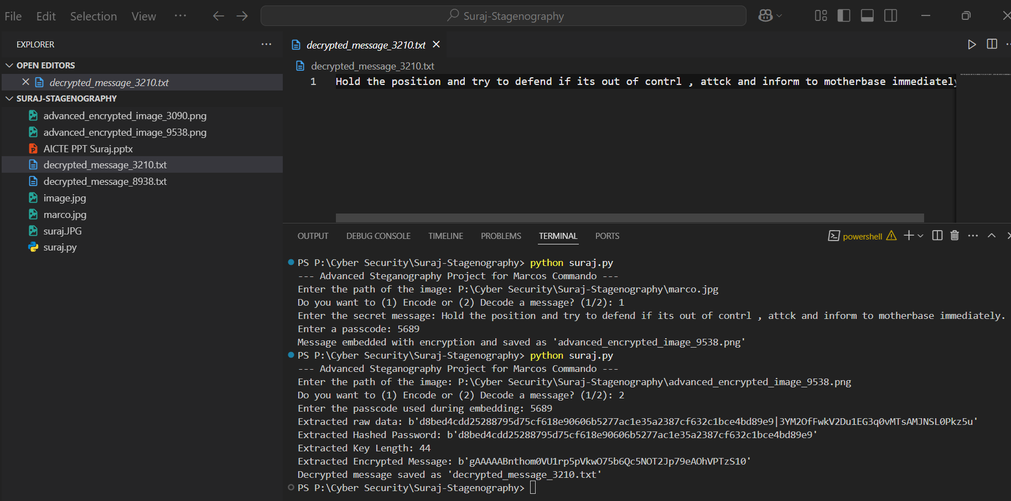
Results
✅ Embedded secret messages in images.
✅ Successful decryption of hidden messages with password verification.
⚠️ Error handling for incorrect passwords or corrupted data.
✅ Automatic saving of encrypted and decrypted files.

Slide 8
Conclusion
The project provides a reliable and efficient steganography tool for Marcos Commando operations, ensuring secure message transmission using advanced encryption, password authentication, and image processing.

Slide 9
GitHub Link
https://github.com/Surajmohapatra49/Marcos-project.git

Slide 10
Future scope (optional)
📹 Extending support for video and audio files.
🔧 Enhancing encryption with customizable algorithms.
🖥️ Developing a user-friendly GUI for non-technical users.

Slide 11
THANK YOU

